Slide 1
CSE202: Introduction to Formal Languages and Automata Theory
Chapter 9
The Turing Machine
These class notes are based on material from our textbook, An Introduction to Formal Languages and Automata, 4th ed., by Peter Linz.

Slide 2
Model of computation
A TM is an abstract model of a computer that lets us define in a precise, mathematical way what we mean by computation.
As before, we use the concept of a “configuration” to define what we mean by computation.

Slide 3
Configuration
A configuration of a TM is a pair,
(q,xay)
where q is a state, x and y are strings, and a is the symbol at the current position of the tape head.
We sometimes use
(q,xw)
To indicate that the tape head is under the first symbol in the string w.

Slide 4
Configuration
A configuration of a TM includes everything we need to know to continue a computation
  current state
  symbol currently under the tape head
  string on tape to left of the head
  string on tape to right of the head (up to rightmost non-blank symbol)
Example
  (q, ΔbbabbbaΔ)

Slide 5
Computation
A computation is a sequence of configurations such that each configuration is obtained from the previous configuration by some transition of the TM
Given input string aabb, the TM that accepts the language a*b* begins a computation as follows: (s, ΔaabbΔ) |- (s, ΔAabbΔ) |- (s, ΔAAbbΔ) |- …
Continue this computation to the end

Slide 6
Example:
Here is the TM to process the language consisting of strings containing any number of a’s, with a single b at the end.
Δ / Δ, R
b / b, R
Δ / Δ, R
q₀
q₁
q₂
h
a / a, R
Δ | a | a | a | b | Δ | Δ

Slide 7
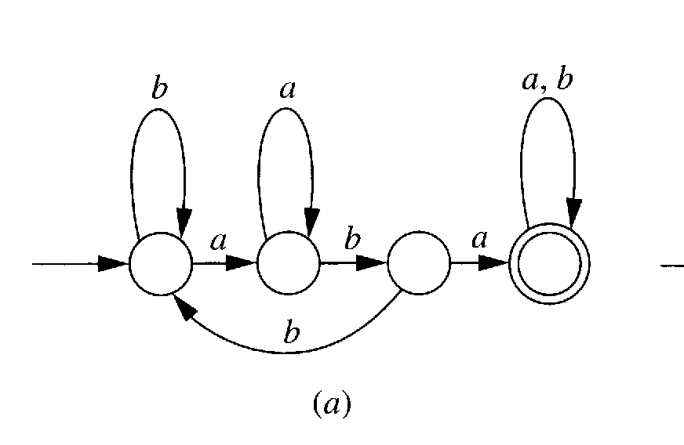
Example:
An FA that accepts {a, b}* {aba} {a, b}*

Slide 8
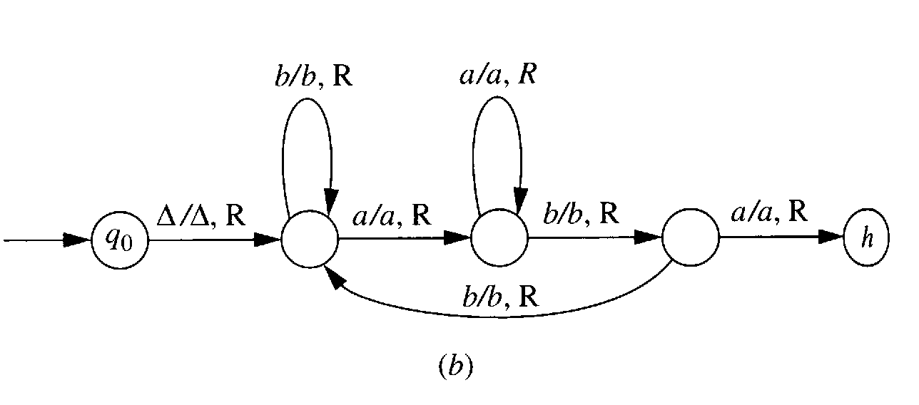
Example:
A TM that accepts {a, b}* {aba} {a, b}*

Slide 9
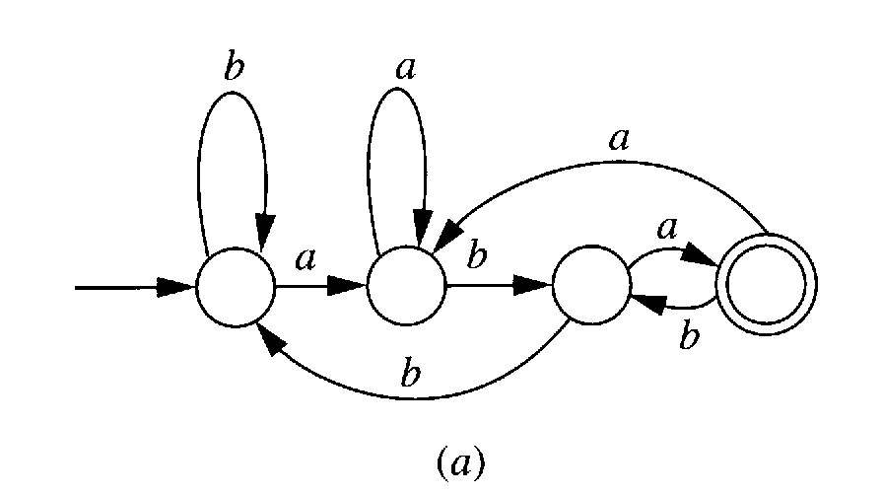
Example:
An FA that accepts {a, b}* {aba}

Slide 10
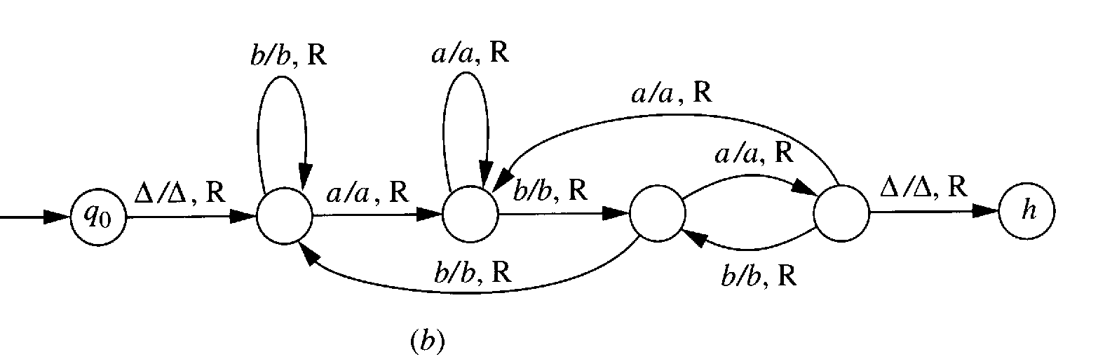
Example:
A TM that accepts {a, b}* {aba}

Slide 11
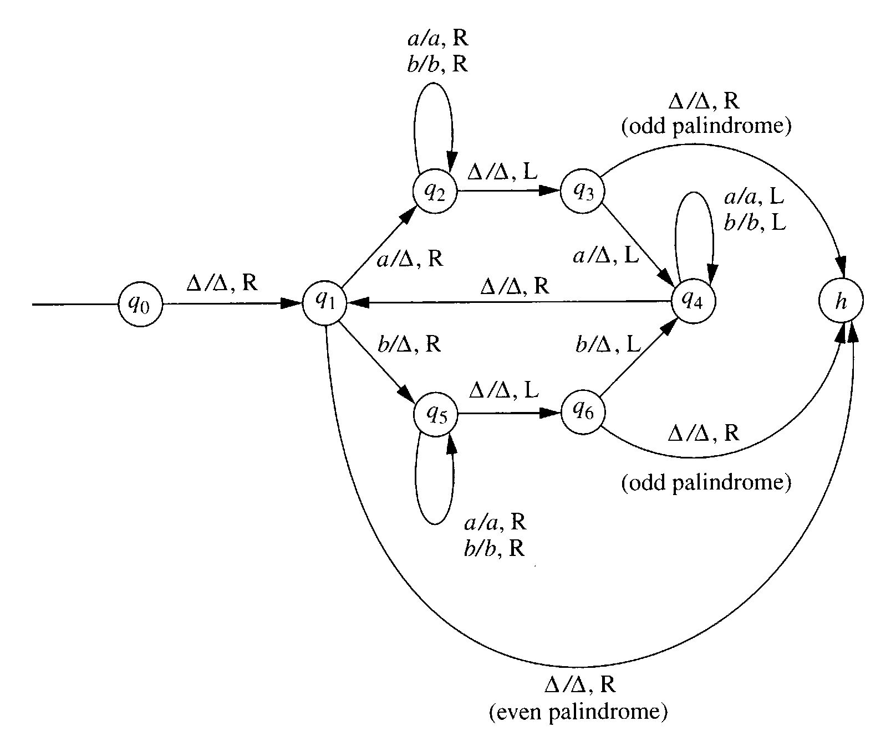
Example:
A TM that accepts pal, the palindrome language:

Slide 12
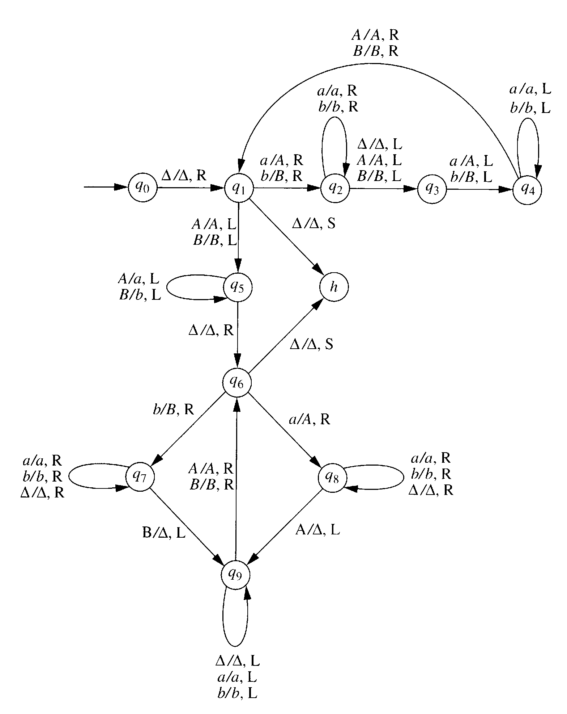
A TM that accepts strings of L = {ss}:

Slide 13
Computable
A function f with domain D is said to be Turing-computable or just computable if there exist some Turing machine M = (Q, Σ, Γ, δ, q₀, Δ, F) such that
q₀w |-_{M}* q_{f} f(w), q_{f} ∈F,
For all w ∈D.

Slide 14
Combining Turing Machines
You can combine several smaller TMs in order to make a larger, more complicated TM.
The composite of two different TMs, T₁ and T₂, is written as T₁T₂. It would be represented as:
T₁ → T₂
What happens is that T₁T₂ begins by executing the moves of T₁, up to the point where T₁ would halt. Instead of halting, T₁T₂ moves to the initial state of T₂, where it begins executing the moves of T₂.
If T₂ halts, then T₁T₂ halts. If T₁ or T₂ crashes, then T₁T₂ crashes.

Slide 15
Combining Turing Machines
You can also make the transition to T₂ conditional.
  a
T₁ → T₂
Here, T₁ would execute its moves up to the point where it would normally halt. If the symbol on the tape at that point is an a, then T₁T₂ will begin executing the moves of T₂. Otherwise T₁T₂ will crash.

Slide 16
Designing complex Turing machines
The book describes a “language” for combining simple TMs into complex ones, using the sequence, branching, and looping operators of imperative programming languages.
If you were going to be a Turing machine programmer, this would be useful.
Since you’re not, you will not be tested on this. But you need to understand how a Turing machine works and how to design simple ones.

Slide 17
Computing functions
We use automata to recognize languages and compute functions (although we haven’t talked about computing functions until now).
In fact, computing functions allows language recognition, since every language can be represented by a characteristic function
  if the input string is in the language, output 1
  otherwise output 0

Slide 18
String and numeric functions
A TM can compute functions on strings. Given an input string, the output of the function is the string left on the tape after the TM halts.
A TM can also compute numeric functions. Using a binary alphabet for strings, the input string can represent a binary number and the output string can represent a binary number.
A TM can compute a function with multiple arguments. Each argument is separated by a blank on the tape.
We can create TMs that compute arithmetic functions such as addition, subtraction, multiplication, etc.

Slide 19
Computing a Partial Function
A Turing Machine can compute a function by leaving a string on the tape when it enters the halt state.
A partial function f on Σ*may be undefined at certain points (the points not in the domain of f).
A total function enters the halt state for all inputs in the domain.
We say that a TM, T, computes f if T halts where f is defined and fails to halt elsewhere. So f is Turing-computable, or just computable, if there exists some TM computing f.

Slide 20
Computing a numerical function
We can represent numbers on a TM by using the unary representation, which just uses n 1’s to represent the number n.
Example: 11111 = 5
We can construct a TM to concatenate two strings together. If we represent two numbers in unary form, then a TM which concatenates these two strings is actually performing addition!

Slide 21
Computing a numerical function
Addition of two numbers as simple as concatenation of two strings.
Assume two integers are represented in unary form on the tape of a Turing machine.
Assume the two integers are separated by a 0 between them.
Design a Turing machine that will add these two numbers.

Slide 22
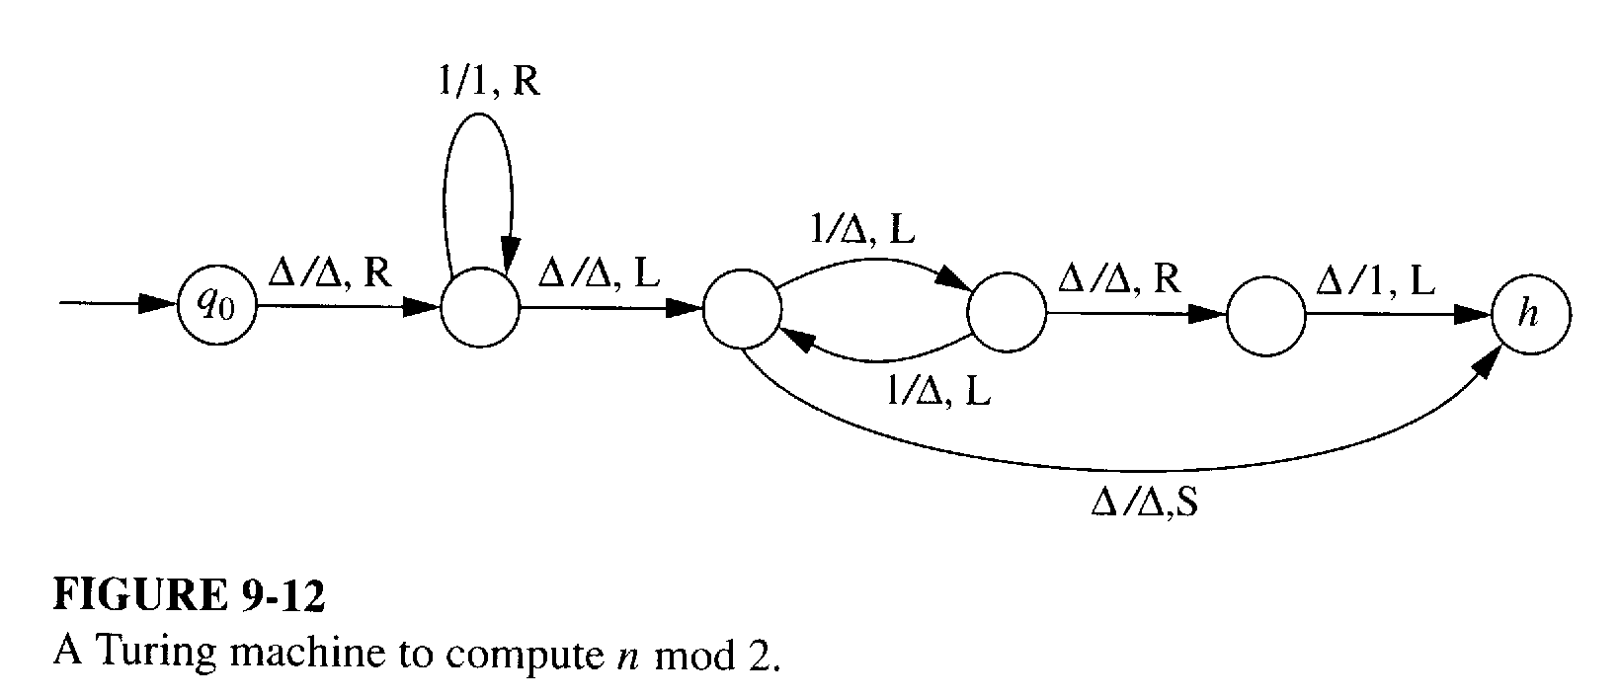
Computing a numerical function

Slide 23
Characteristic Function
Computing the characteristic function Χ_{L} is very similar to accepting a language.
The TM must always halt.
The TM will leave a 1 on the tape if string is accepted, a 0 otherwise.
HOWEVER: A TM can accept a language if it halts on all strings that are in the language, but doesn't halt on strings which are not.

Slide 24
Characteristic function:
In a standard TM, strings which are not accepted can cause the TM to:
  crash if it enters a state where there are no transitions for the current tape symbol,
  crash if it tries to move left at the left end of the tape, or
  get into an infinite loop,
A TM computing the characteristic function must halt on all inputs

Slide 25
Conclusion:
Anything that is effectively calculable can be executed on a TM.
A universal TM can compute anything that any other Turing machine can compute.
The universal TM is itself a standard TM.
A CPU with RAM is a finite version of a TM; it has the power of a TM up to the point that it runs out of memory.
Languages or hardware that provides compares, loops, and increments are termed Turing complete and can also compute anything that is effectively calculable.

